Slide 1
VI International Maritime Conference Waiting for Fair Winds Tallinn 24.09.2010
The effects of SECA and NECA on shipping
Olof Widén
Finnish Shipowners’ Association

Slide 2
IMO decision on Sulphur regulations for Marine Fuel (Marpol Annex VI)
No feasibility study
In EU 0.1% Sulphur for ships at berth effective on 1 January 2010

Slide 3
Geographical area of the IMO sulphur regulation
The Sulphur Emission Control Area (SECA)
Countries with water only in SECA
Countries with part of the coast in SECA
Countries without coast in SECA
Has not signed the Marpol convention

Slide 4
The IMO decision on sulphur will give a substantial cost increase
Low sulphur fuel (0,1 %) - cost increase of 75 %
0,5 % sulphur in fuel - cost increase of 10 %
Source: Preem
Regular bunker oil
The light blue line is marine fuel with a 0,1-0,2 % sulphur content and the yellow line is bunker oil, the marine fuel used world wide today. Even though price varies over time the price difference between low sulphur fuel and bunker oil is almost always around 250-300 USD/tonne. Dark blue line is 0,5 % sulphur content in marine fuel.

Slide 5
1. The Finnish note to the Secretary General of IMO about not accepting the amendments in Marpol Annex VI
Referring to the Marpol-convention article 16 paragraph (2) (f) (ii) that is stipulating about the quiet acceptance by two thirds of the parties, the combined merchant fleets of which constitute not less than 50 % of the world’s merchant fleet.
”Nevertheless at any time before entry into force a party may notify the secretary general of IMO that its express approval will be necessary before the amendments enters into force for it”.
The dead-line for this declaration was 1.1.2010.

Slide 6
2. The Estonian note to the Secretary General of IMO about not accepting the amendments in Marpol Annex VI
Referring to Marpol convention article 16 paragraph (2) (g) (ii) stipulating that an amendment enters into force six months after its acceptance for all the parties with the exception of:
“those which before that date [1.1.2010] have made a declaration that they do not accept it or a declaration under sub-paragraph (f) (ii) that their express approval is necessary.
The dead-line for this declaration is 1.7.2010.

Slide 7
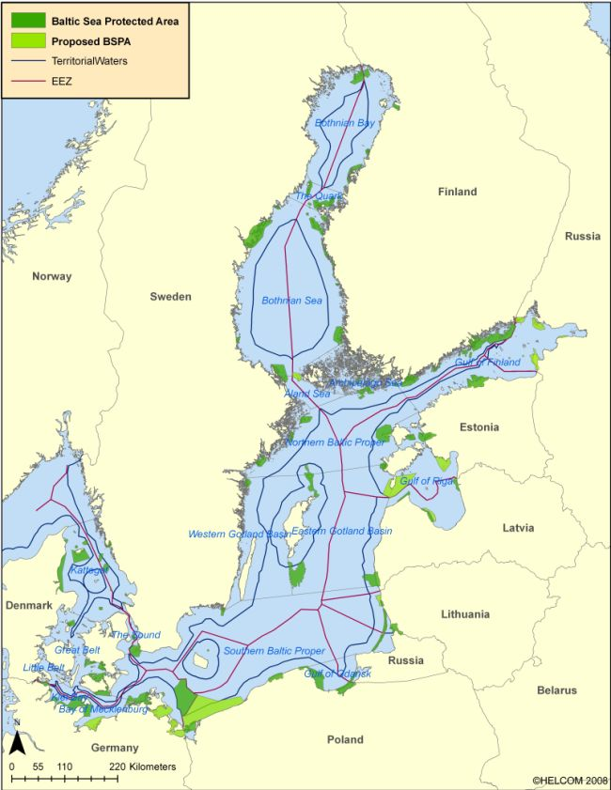
MARPOL Annex VI 1.7.2010
What did Finland and Estonia gain from their notes?
FIN & EST flagged vessels will continue trading in their territorial waters and eco-nomical zones with 1.5% bunker

Slide 10
The new IMO Sulphur regulation for North Europe is unacceptable since it creates a trade barrier within the European Internal Market and will lead to a modal back-shift. A constructive and alternative solution is needed. Actions must be taken during 2010.
Suggested solution for the North European (S)ECA 2015 = 0.5 %
2012 =Impact assessment of (S)ECA to be included in the global review
MEPC 61 National Co-ordinations
MEPC 62 National Co-ordinations
Industry-Group
Third meeting?
MEPC 61 EU Co-ordination
MEPC 62 EU Co-ordination
ECSA/SEC
ICS/Board
Commission
Stakeholders meeting postponed
until?
MEPC 61 27Sep – 01 Oct
MEPC 62 July 2011
ECSA/Board
February
March
April
May
June
July
August
September
October
FSA/SSA Letter to ECSA
MEPC 62 ICS Submissions
MEPC 61 ICS submissions
Correspondent group
Entec study
ICS/board
ECSA Letter to ICS
Industry-Group
Official letter to the Commission?

Slide 11
The ECSA Board of Directors agreed at its June 30th meeting on the following position
To maintain the ECSA support for a change of the 0.1 % to 0.5 % in 2015.
The shipping industry can be open and positive to a possible change of the time scale to 2020 as considered by some Member States. Much will depend on the further process on the attitude of Member States.
To strongly support a submission by ICS of the ENTEC study summarising the results of all studies made. Purpose of the submission is to bring forward the feasi-bility study to be made in IMO on Annex VI from 2018 to 2012. The feasibility study should include the 0.1 % in the ECAs. The ENTEC study could lay the basis. This would have to be decided at MEPC 62 in July 2011.

Slide 12
Transport ministers concerned over IMO sulphur regulations, Antwerp 16.09.2010
Several EU-ministers shared the concern over the impacts of the sulphur regulations on costs. However, the discussions indicated that the EU countries are not ready to change the decision made at the IMO.
The Finnish transport minister Ms Vehviläinen expressed that she personally would be prepared to consider a postponement of the IMO timetable, but she got support for these thoughts only from the Estonian transport minister.
Finland also, alongside with a number of other countries, brought up the potential that new technology, such as scrubbers and alternative fuels, offer in terms of ensuring a cleaner Short Sea Shipping sector.

Slide 13
Marine Fuels Outlook
The global demand 2008 was 370 Mtons.
The balance between IFO 180/380 and MDO/MGO was, 290 million tons and 80 million tons.
The estimated global demand 2015 is 410 Mtons
The balance between IFO 180/380 and MDO/MGO with 0.1 % in ECAs is, ? Mtons and ? Mtons.
The estimated global demand 2020 is 450 Mtons
The balance between IFO 180/380 and MDO/MGO with 0.1 % in ECAs and 0.5 % is, ? Mtons and ? Mtons.

Slide 14
THE WAY FORWARD
IMO MEPC 61 outcome
The governments must support the ICS proposal to establish a correspondent group.
The missing link
Support from flag states is needed for ICS to go forward.
IMO MEPC 62
Is going to be held in July 2011. Are there concerns regarding this shortage of time? YES

Slide 15
NOx (Nitrogen Oxides)
HELCOM is preparing a proposal for IMO MEPC 62 in july 2011 to designate the Baltic Sea as an emission control area ECA for Nitrogen Oxides NOx.
This proposal is prepared by: Denmark, Estonia, Finland, Germany, Lithuania, Latvia, Poland, Russian Federation and Sweden.

Slide 16
NEW LIMITS FOR NOx EMISSIONS FOR DIESEL ENGINES
New Annex VI entered into force 1 July 2010.
Tier I NOx regulations will be applied retroactively to certain types of diesel engines on ships constructed on or after 1 January 1990 but prior to 1 January 2000.
Power output of more than 5 000 kW
A per cylinder displacement at or above 90 litres
Tier II NOx regulations will be applied to a marine diesel engine installed on a ship constructed on or after 1 January 2011.
Tier III NOx regulations will be applied to a marine diesel engine installed on a ship constructed on or after 1 January 2016, when the ship is operating in an Emission Control Area for NOx emissions.

Slide 17
THE NEW LIMITS FOR NOx EMISSIONS FOR DIESEL ENGINES

Slide 18
The statement of Finnish Shipowners’ Association FSA
FSA has been arguing for a proper and fundamental NECA-impact study to be performed.
There is an insistence for such a study to be completed before any NECA-submission to IMO can be accepted.
This NECA-study must be carried out both for the impact- and the health aspect and in parallel for the North Sea & English Channel area and the Baltic Sea.
For the moment the OSPAR countries are not preparing a NECA-proposal for the North Sea & English Channel area.

Slide 19
Three different studies in preparation
Environmental and health impacts, done by the Finnish Meteorological Institute, whole Baltic Sea area;
2. Impacts on transportation costs in the whole Baltic Sea area, done by University of Turku;
3. Impacts on transportation costs in Finland (in Finnish), done by University of Turku.

Slide 20
The way forward in the NOx issue is a joint HELCOM & OSPAR application
The next HELCOM Maritime meeting is going to be kept in November 2010. A decision will be made about a submission to IMO.
The North Sea ECA (OSPAR) must be part of a proposal to IMO.
Both European Community Shipowners’ Association ECSA and International Chamber of Shipping ICS have today an observatory status in HELCOM.

Slide 21
Thank you for your attention!
olof.widen@shipowners.fi
www.shipowners.fi
Hämeentie 19, FI-00500 Helsinki or,
Hamngatan 8, AX-22100 Mariehamn

